Slide 1
True Companion
“Your empathetic, adaptive voice-first companion”

Slide 2
Introduction
A sophisticated, voice-first, multilingual AI companion designed for mental wellness support
Uses real-time audio streaming, sentiment analysis, and a multi-agent persona engine
Goal: Provide empathetic, adaptive conversations that feel natural and supportive

Slide 3
🌟 How It Works
Connects directly to Google Gemini Multimodal Live API
Enables low-latency voice conversations
Not just a chatbot → a “feeling” companion that adapts personality to emotional state

Slide 4
🎙️ Core Features
Real-time voice interaction via WebSockets
Connects to gemini-2.5-flash-native-audio LIVE API
Instant, interruption-friendly conversations
No text-to-speech lag → native audio generation

Slide 5
🧠 Multi-Agent Persona Engine
Dynamically switches personas based on vocal tone & sentiment
Examples:
Shaky/distressed → DEEPLY_EMPATHETIC_LISTENER (warm, slower pace)
Positive → PLAYFUL_QUIRKY_FRIEND
Unstable → CALM_GROUNDING_STABILIZER

Slide 6
🚨 Crisis Intervention Protocol
Human-in-the-Loop (HITL) safety mechanism
Detects intent of self-harm → triggers Emergency Protocol
AI pauses → shows modal with local helpline numbers (e.g., 988)

Slide 7
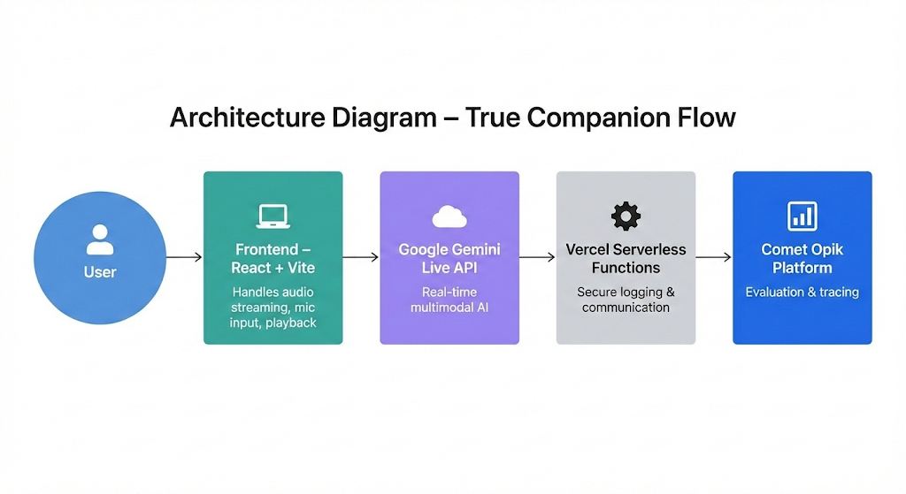

Slide 8
Benefits
Empathetic, adaptive support for mental wellness
Real-time, natural voice-first interaction
Built-in safety & crisis intervention
Continuous evaluation for quality assurance

